Slide 1

Hybrid AI Movie Recommender
A Comprehensive Technical Deep-Dive into Advanced Recommendation Systems
Youssef Ibrahim
Karem osama
Mohamed hamdy
Ahmed Yasser
Zeyad mohamed

Slide 2
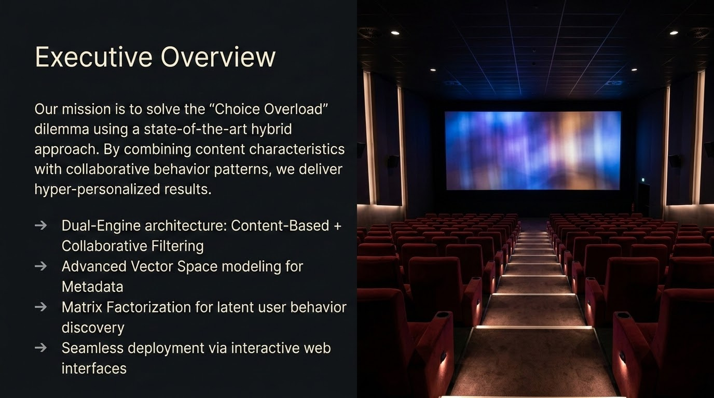

Slide 3



The Challenge: Data Sparsity
The modern user is overwhelmed by thousands of titles, yet typically interacts with less than 0.1% of the database.
Sparsity Problem
Standard algorithms struggle when user-item interaction matrices are mostly empty, leading to inaccurate suggestions.

Slide 4


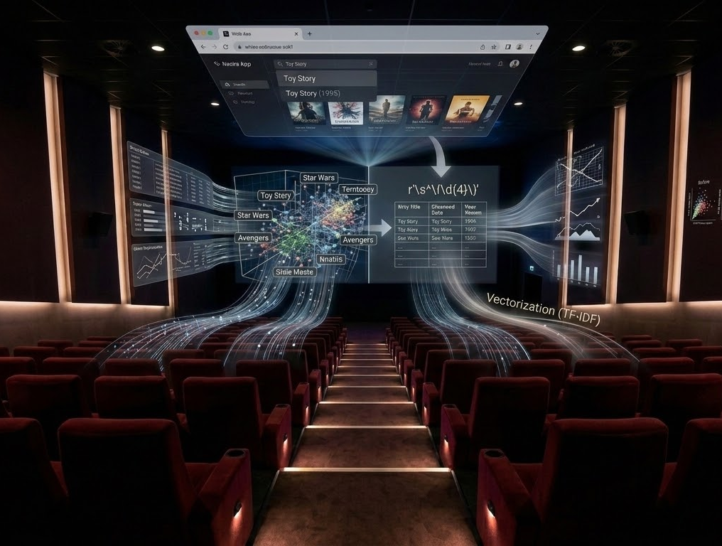

Challenge: Dirty Metadata
The Problem:
Movie titles were polluted with year data like "Toy Story (1995)". This noise confused search engines and skewed the TF-IDF feature weights during vectorization.
Strategic Solution:
Implemented Regex Engineering to surgically extract years into a discrete feature column and strip titles for pure string matching.

Slide 5




Challenge: The Cold Start
New User Obstacle
New Item Obstacle
New users have zero history. Matrix Factorization (SVD) fails instantly as it has no behavioral latent features to anchor on.
Newly released films have no ratings. Collaborative Filtering treats them as "Invisible," preventing organic discovery by users.
Solution: Fallback to Session Context (Content-Based) only.
Solution: Similarity anchoring via Genre Metadata vectors.

Slide 6

Challenge: Popularity Bias
Common genres like "Drama" occur in thousands of titles, while "Film-Noir" is rare. Simple frequency counts would result in shallow, generic recommendations.
The Fix: We used TF-IDF to penalize ubiquitous genres and grant "Golden Weights" to unique category markers.

Slide 7
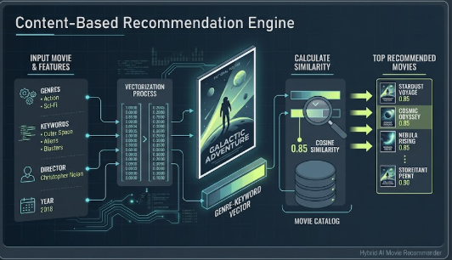
Content Based

Slide 8




TF-IDF & Genre Mastery
We apply TF-IDF Vectorization to movie genres to weigh unique categories (e.g., "Film-Noir") higher than generic ones (e.g., "Drama").
→
Regex cleanup for year extraction from titles.
→
Min-Max Scaling for normalized rating inputs.
→
Multi-Label Binarization for categorical genres.

Slide 9

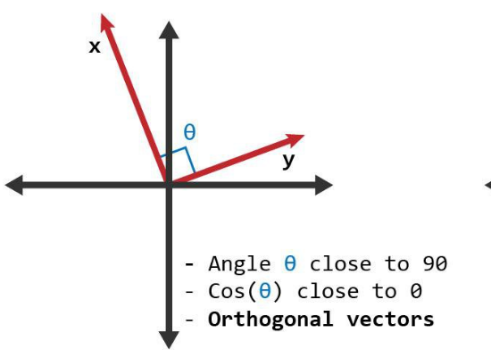

Content-Based Logic
This engine focuses purely on Item Metadata. It builds a similarity matrix using the angle between movie vectors.
Primary Benefit: Solves the Item Cold Start problem—new movies can be recommended as soon as genres are assigned.

Slide 10


Tackling Cold Start
New users and new items represent "Cold" entities. Our hybrid system acts as a thermal regulator:
Item Cold Start: Content-Based vectors allow recommendations without a single rating.

Slide 11

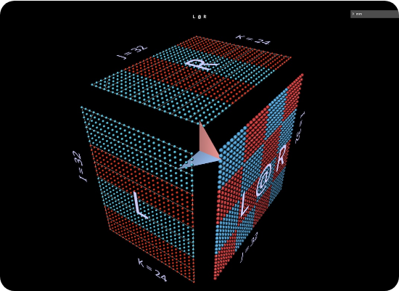
Matrix Factorization: SVD
Using the Surprise library, we implement Singular Value Decomposition (SVD) to uncover latent features.
→
Decomposes User-Item matrix into low-rank representations.
→
Identifies "hidden" themes in user behavior.
→
Predicts the numerical rating for unseen movies.
It captures Personalization by learning what similar users enjoyed in the past.

Slide 12






The Cascade Hybrid Design
Recall Phase
Ranking Phase
Final Selection
Content-Based Filtering filters the top 100 similar movies based on the queried title.
SVD predicts user ratings for the candidates and ranks them according to specific user tastes.
The top 5 hyper-personalized recommendations are served to the interface.

Slide 13

Tackling Cold Start
New users and new items represent "Cold" entities. Our hybrid system acts as a thermal regulator:
User Cold Start: We use real-time session search context (Fallback) until enough ratings trigger the SVD engine.

Slide 14


Validation & Metrics
We quantify performance using statistical error metrics on the test set.
→
RMSE: Aiming for < 0.9 for high accuracy.
→
MAE: Measuring absolute prediction deviation.
→
Sanity Check: Manual verification for genre consistency.

Slide 15

Interactive Deployment
The system is deployed using Streamlit, providing a seamless user experience.
→
Real-time search-to-recommendation pipeline.
→
Cloud integration for global accessibility.
→
Efficient caching mechanisms for rapid matrix lookup.
→
Personalized dashboard per User ID.

Slide 16
Any Questions?
Thank you for your attention. The project code is available on GitHub.

